Slide 1
Niranjan Khakurel
{niranjan@ncit.edu.np}
Computer Graphic and Multimedia System
[BE SW 4th Semester]

Slide 2
Unit 6: Multimedia System and Media Representation
(7 hrs)
6.1 Multimedia System
6.1.1 Definition, Scope and Properties
6.1.2 Continuous and discrete media
6.1.3 Evolution and trends in multimedia technology
6.1.4 Analysis of common image formats (BMP,JPEG and PNG)
6.1.5 Applications of multimedia systems
6.2 Sound and Audio
6.2.1 Digital audio formats (WAV and mp3)
6.2.2 Audio sampling and quantization
6.2.3 Frequency, amplitude and waveform
6.2.4 MIDI hardware, software and messages
6.3 Video:
6.3.1 Digital video formats (AVI and MOV)
6.3.2 Video codecs, frame rate, resolution and color
depth
6.4 Animation:
6.4.1 Hand drawn, stop motion and computer
animation
6.4.2 Morphing

Slide 3
1. Multimedia
1. Overview of Multimedia, Building Blocks of multimedia
1.1 The Medium aspects,
- Application areas and usefulness,
- Properties of multimedia
1.2 Global Structure of Multimedia
1.3. Data Stream Characteristics:
a. Asynchronous and
b. Synchronous Transmission Mode

Slide 4
1.1 Introduction
Any kind of system that supports more than one kind of media
• Multi - many; much; multiple
• Medium - a interleaving substance through which something is transmitted or carried on
Classification based on perception (text, audio, video) is appropriate for defining multimedia

Slide 5
1.1 Introduction
Multimedia is defined as the computer based interactive environment that incorporates text, images, graphics, sound, audio, animation, video and virtual reality (VR).
Multimedia means integration of continuous media (e.g. audio, video) and discrete media (e.g. text, graphics , images ) through which digital information can be conveyed to the user in appropriate way.

Slide 6
1.1 Introduction
Time always takes separate dimension in the media representation
Based on time-dimension in the representation space, media can be:
• Time-independent (Discrete)
→ Text, Graphics
• Time dependent (Continuous)
→ Audio, Video
→ Video, sequence of frames (images) presented to the user periodically.
• Discrete & Continuous here has no connection with internal representation!! (Relates to the viewers impression...)

Slide 7
1.1 Introduction
•
Multimedia is any combination of digitally manipulated
text, art, sound, animation and video.
•
A more strict version of the definition of multimedia do not
allow just any combination of media.
•
It requires
•
Both continuous & discrete media to be utilized
•
Significant level of independence between media being used

Slide 8
1.1 Introduction
•
Multimedia is interactive when the end-user is allowed to
control what and when the elements are delivered.
•
Interactive Multimedia is Hypermedia, when the end-user
is provided with the structure of linked elements through
which he/she can navigate.

Slide 9
1.1 Introduction
Multimedia is
linear
, when it is not interactive and the
•
users just sit and watch as if it is a movie.
Multimedia is
nonlinear
, when the users are given
•
the navigational control and can browse the contents at
will.

Slide 10
1.2. The medium aspect
•
Multimedia System: one way of defining multimedia can
be found in the meaning of composed world multi-many,
much multiple.
•
Medium: An intervening substance through which some
thing is transmitted or carried on.
•
Computer System medium:
1. Text
2. Image
3. Sound
4. Video

Slide 11
1.2. The medium aspect
Medium is defined as means for distribution and
presentation of information.
Examples of a medium are text, graphics, speech,
and music. Media can be classified with respect to different
criteria.
We
classify
media
according
to
perception,
representation,
presentation,
storage,
transmission,
and
information exchange.

Slide 12
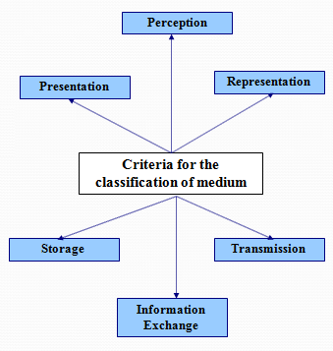
1.2. The medium aspect

Slide 13
1.2. The medium aspect
Classification of Media :
1.
The perception media
2.
The representation Media
3.
The presentation Media
4.
The storage media
5.
The transmission media
6.
The information Exchange media

Slide 14
1.2. The medium aspect
Classification of Media :
1. The perception media
Perception media help human to sense their environment. The
central question is how human perceive information in a computer
environment. The answer is through seeing and hearing.
•
Seeing: For the perception of information through seeing the
usual such as text, image and video are used
•
Hearing:
For
the
perception
of
information
through
hearing
media such as music, noise and speech are used.

Slide 15
1.2. The medium aspect
Classification of Media :
2. The representation Media
Representation media are defined by internal computer
representation of information. The central question is how the
computer information is coded? The answer is that various
format
are
used
to
represent
media
information
in
computer.
•
Text, character is coded in ASCII code
•
Graphics are coded according to CEPT (Conference of European
Postal
and
Telecommunications
Administration)
or
CAPTAIN
(Character
and
Pattern
Telephone
Access
Information
Networks)
video text standard.
•
Image can be coded as JPEG format
•
Audio video sequence can be coded in different TV standard format
(PAL, NTSC, SECAM and stored in the computer in MPEG format)

Slide 16
1.2. The medium aspect
Classification of Media :
3. The Presentation Media
Presentation media refer to the tools and devices for
the
input and
output
of
the
information. The
central
question is, through which the information is delivered
by the computer and is introduced to the computer.
•
Output media: Paper, screen and speaker are the output media.
•
Input Media: Keyboard, mouse, camera, microphone are the
input media.
•
Digital Media: Soft copy presentation.
•
Paper Media: Hard copy presentation.

Slide 17
1.2. The medium aspect
Classification of Media :
4. The storage media
Storage
Media
refer
to
the
data
carrier
which
enables storage of information. The central question is,
how will information be stored? The answer is hard disk,
CD-ROM, etc.

Slide 18
1.2. The medium aspect
Classification of Media :
5. The transmission media
Transmission
Media
are
the
different
information
carrier that enables continuous data transmission. The
central
question
is,
over
which
information
will
be
transmitted? The answer is co-axial cable, fiber optics
as well as free air.

Slide 19
1.2. The medium aspect
Classification of Media :
6. The information Exchange media
Information exchange media includes all information
carrier for transmission, i.e. all storage and transmission
media.
The
central
question
is,
which
information
carrier
will
be
used
for
information
exchange
between different places? The answer is combine uses
of
storage
and
transmission
media.
E.g.
Electronic
mailing system.

Slide 20
1.3. Main Properties ...
The uses of term multimedia are not every arbitrary
combination of media. The main properties of multimedia
system are:
1.
Combination of media
2.
Computer support integration
3.
Communication systems
4.
Independence

Slide 21
1.3. Main Properties ...
1. Combination of media
simple text processing program with in corporate
image is often called a multimedia application.
Because two media are processed through one
program. But one should talk multimedia only when both
continuous
and
discrete
media
are
utilized.
So
text
processing
program
with
incorporated
images
is
not
a
multimedia application.

Slide 22
1.3. Main Properties ...
2. Computer support integration
Computer is idle tools for media combinations. The
system should be capable of computer-controlled media
processing. The system should be programmable by a
system programmer or even a user.
3.Communication System
Communication-capable
multimedia
systems
must
be approached. A reason for this is that most of today’s
computers
are
interconnected;
considering
multimedia
functions from only the local processing viewpoint would be
a restriction, if not a step back.

Slide 23
1.3. Main Properties ...
4. Independence:
An important aspect of different media is their level
of independence from each other. In general there is a
request for independence of different media but multimedia
may requires several level of independence.
E.g. A computer controlled video recorder stores
audio and video information's. There is inherently tight
connection between two types of media. Both media are
coupled together through common storage medium of tape.
On the other hand for the purpose of presentation the
combination of DAT (digital audio tape recorder) signals
and computer available text satisfies the request for media
independence.

Slide 24
1.4. Definition of Multimedia System
A multimedia system is characterized by computer-controlled, integrated production, manipulation, presentation, storage and communication of independent information which is encoded at least through a continuous(time-dependent) and a discrete(time-independent) medium.

Slide 25
Applications of Multimedia System
Multimedia plays major role in following areas:
•
Instruction (Teaching)
•
Business
•
Advertisements
•
Training materials
•
Presentations
•
Customer support services
•
Entertainment
•
Interactive Games
•
Enabling Technology
•
Accessibility to web based materials
•
Teaching-learning disabled children & adults
•
Fine Arts & Humanities
•
Museum tours
•
Art exhibitions
•
Presentations of literature

Slide 26
1.4. Definition of Multimedia System
Usages of Multimedia Application:
1. Education
2. Training
3. Entertainment
4. Advertisement
5. Presentation
6. Business Communication
7. Web page Design

Slide 27
1.4. Definition of Multimedia System
Multimedia Tools:
•
Text Editing Tools
•
Drawing and Painting Tools
•
Image Editing Tools
•
Audio Editing Tools
•
Video Editing Tools
•
Animation and 3D Modeling Tools
•
OCR (optical character recognition)Tools
•
Voice Recognition Tools

Slide 28
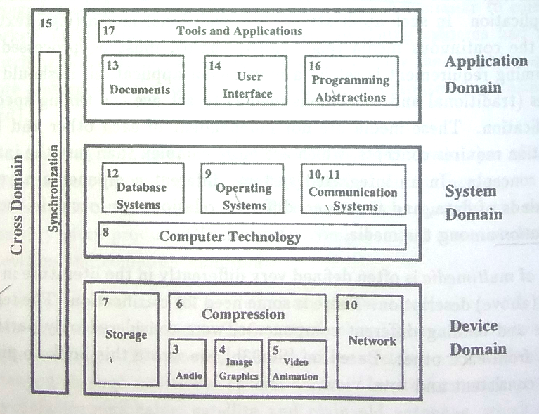
Global Structure of Multimedia System

Slide 29
Global Structure of Multimedia System
1.
Device domain
2.
System domain
3.
Application domain
4.
Cross domain

Slide 30
Global Structure of Multimedia System
1. Device domain
It
deals
with
interaction
between
multimedia
application and multimedia devices
such
as
AGP(Accelerated
Graphics
Port)
Card,
Sound Card etc.
Basic concepts for the processing of digital audio
and video data are based on digital signal processing.
Different methods for the processing of image, graphics
and animation are described.
The audio techniques section includes music MIDI
(Musical
Instrument
Digital
Interface)
and
speech
processing.

Slide 31
Global Structure of Multimedia System
2. System domain
The interface between the device domain and the
system domain is specified by the computer technology.
To utilize the device domain, several system services are
needed. Basically, three services exits.
These services are mostly implemented in software. The
operating system, serves as an interface between computer
hardware/system and all other software components.
It
provides
the
user
with
a
programming
and
computational
environment,
which
should
be
easy
to
operate.
The database system allows a structured access to data
and a management of large databases. The communication
system is responsible for data transmission according to the
timing and reliability requirements of the networked multimedia.

Slide 32
Global Structure of Multimedia System
3. Application domain
Provides functions to the user to develop and
present multimedia projects.
This
includes
software
tools,
and
multimedia
projects development methodology.
The services of the system domain are offered to the
application
domain
through
proper
programming
abstractions. Another topic embedded in the application
domain is document handling.

Slide 33
Global Structure of Multimedia System
4. Cross domain
It
turns
out
that,
some
aspects
such
as
synchronization aspects, are difficult to locate in one or
two
components
or
domains.
The
reason
is
that
synchronization,
being
the
temporal
relationship
among
various media, relates to many
components across all
domains.

Slide 34
1.6. Traditional Data Stream Characteristics
In
multimedia
communication
system
data
of
discrete
and
continuous
media
are
transmitted
and
information access takes place.
This transmitted information is divided into small
individual unit known as
packets
.
Packets can carry information of either continuous
or discrete media
A
sequence
of
individual
packets
transmitted
in
a
time
dependent
fashion
is
called a data stream
. The data stream will be used as
a synonym data flow.

Slide 35
1.6. Traditional Data Stream Characteristics
Transmission of information carrying different media
leads to data stream with very different features.
The attributes of
synchronous
,
asynchronous
and
isochronous
data transmission conforms the field of
computer communication and switching. Transmission of
the
data
packets
takes
place
in
any
of
the
following
transmission modes:
Asynchronous Transmission mode:
Synchronous Transmission mode:
Isochronous Transmission mode:

Slide 36
1.6. Traditional Data Stream Characteristics
Asynchronous Transmission mode:
•
The
asynchronous
transmission
mode
provides
for
communication with no timely restriction (limit).
•
Packets reach the receivers as fast as possible.
•
All
information
of
discrete
media
can
be
transmitted
as
asynchronous data stream.
•
If
an
asynchronous
mode
is
chosen
for
transmission
of
continuous media, additional technique most be applied to
provide the time restriction.
•
E.g.:
Ethernet,
protocol
of
worldwide
internet
for
e-mail
transmission.
•
No time bound (E.g. postal service)
•
E.g. mail system.

Slide 37
1.6. Traditional Data Stream Characteristics
Synchronous Transmission mode:
•
The synchronous transmission mode defines the
maximum
end to end delay for each packet of the data stream.
•
This upper bound will never be violated. (E.g. Ping operation)
•
Moreover,
a
packet
can
reach
the
receiver
at
any
arbitrary(random)
earlier
time.
So
most
of
the
time
the
receiver has to hold the packet temporarily
•
A packet has a start frame and the end frame.
•
Start frame is used to tell the receiving station that a new
packet of characters is arriving and used to synchronize the
receiving station's internal clock.
•
The end frame is used to indicate the end of packet.
•
For retrieving uncompressed video at data rate 140Mbits/s &
maximal end-to-end delay 1 second the receiver should have
temporary storage 17.5 MBytes

Slide 38
1.6. Traditional Data Stream Characteristics
Isochronous Transmission mode:
•
Defines maximum & minimum end-to-end delay
•
This
means
the
delay
jitter
for
individual
packet
is
bounded.
•
Isochronous transmission mode minimizes the overhead
of the receiver.
•
Upper time bound + lower time bound (E.g. TV systems)
•
Data will reach destination in between these upper and
lower bound time.
•
Less
storage
buffer
at
receiver
is
needed
than
the
synchronous transmission mode.
•
Storage requirements at the receiver reduces

Slide 39
1.6. Traditional Data Stream Characteristics
Data stream characteristics for continuous media
Characteristics for continuous media can be classified according to:
Time interval between a complete transmission of consecutive packets
Periodicity
(a) Strongly Periodic
(b) Weakly Periodic
(c) Aperiodic
Variation in amount of consecutive packet amount
(a) Regular
(b) Weakly regular
(c) Irregular
Contiguous packets
(a) Continuous
(b) Discrete

Slide 40
1.6. Traditional Data Stream Characteristics
Time interval based characteristics:
(1) Strongly periodic data stream transmission:
T
Time interval between two consecutive packets is constant. E.g.
PCM-coded
speech
used
in
traditional
telephone
switching
systems. It is also called strongly periodic.

Slide 41
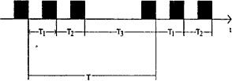
1.6. Traditional Data Stream Characteristics
Time interval based characteristics:
(2) Weakly periodic data stream transmission
:
Time interval between the consecutive packets is of periodic nature.
Duration of time interval between two consecutive packets can be
described by using a periodic function with finite period. But, time
interval between two consecutive packets is not constant.

Slide 42

1.6. Traditional Data Stream Characteristics
Time interval based characteristics:
(3) Aperiodic data stream transmission:
Sequence of the time interval between packets is neither strongly
nor
weakly
periodic.
e.g.
Cooperative
application
with
shared
Window.

Slide 43
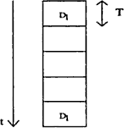
1.6. Traditional Data Stream Characteristics
Packet Amount based characteristics:
(1) Strongly regular data stream
Data size of all the packets is constant. Amount of the data stays
constant during the life time of a data stream. E.g. Uncompressed
digital data transmission, video stream taken from a camera in
uncompressed form, and the audio stream from an audio CD.

Slide 44
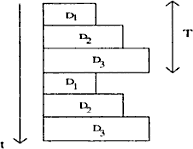
1.6. Traditional Data Stream Characteristics
Packet Amount based characteristics:
(2) Weakly regular data stream:
Data
size
of
the
packets
changes
periodically
(with
time).
E.g.
compressed video stream

Slide 45
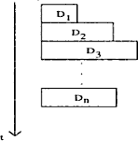
1.6. Traditional Data Stream Characteristics
Packet Amount based characteristics:
(3) Irregular data stream
Data size of the packets is neither constant nor changing periodically
according to a periodic function. Transmission and processing is more
complicated.

Slide 46
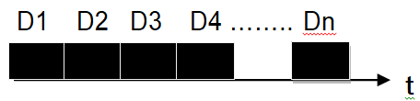
1.6. Traditional Data Stream Characteristics
Contiguous packets based characteristics:
It characterizes continuity, or connection between
consecutive packets. Is consecutive packets transmitted
directly one after another, or is there a gap between the
packets.
(1) Continuous data stream
Packets
are
transmitted
without
intermediate
gaps.
Also
called
connected information transfer. It allows maximum data throughput. E.g.
B-channel of ISDN with 64 Kb audio data transmission

Slide 47

1.6. Traditional Data Stream Characteristics
Contiguous packets based characteristics:
(2) Discrete data stream:
Gap exists among the packets. Also called unconnected data
stream. Duration of the gap may vary.

Slide 48
1.6. Traditional Data Stream Characteristics
Streaming Media
•
Popular approach to continuous media over the internet
•
Playback at users computer is done while the media is
being transferred (no waiting till complete download!!!)
•
You can find streaming in
•
Internet radio stations
•
Distance learning
•
Cricket Live!!!
•
Movie Trailers

Slide 49
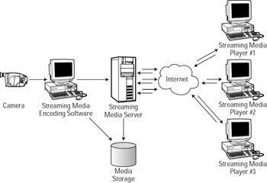
Streaming Media

Slide 50
1.7. Information Units
Continuous media consists of a time dependent
sequence
of
individual
information
units.
Such
an
information unit is called a LDU (logical data unit). With
respect to time there can be Closed LDU and Open LDU.
•
Closed LDU
•
Predefined duration is present.
•
E.g. data stream characteristics of audio samples in the computer.
•
Open LDU
•
Duration is not known in advance.
•
E.g. Data stream sent from camera/ microphone to computer.

Slide 51
1.7. Information Units
The
most
general
names
and
best-known
information units are the symphony and the movie. LDU is
the whole symphony, individual sentences, individual notes,
grouped samples of 1/75 second duration or just individual
samples.
An example is an uncompressed video sequence
consisting of individual video clips which presents a specific
scene. Such a scene is comprised of a sequence of image.
An image can be divided into group of pixels. Each pixel
consist luminance and chrominance values. The image is
therefore not the only possible LDU of a video sequence. A
scene or a pixel also can be an LDU.

Slide 52
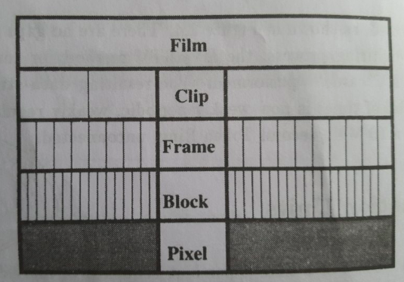
1.7. Information Units
Figure: Granularity of a motion picture sequence

Slide 53
Assignment I
1.
Define
multimedia.
Explain
the
application
areas
of
multimedia.
2.
What
is
Multimedia?
Explain
global
structure
of
multimedia system.
3.
Define application domain? Explain the different criteria
that
are
used
to
classify
media
in
the
multimedia
system.
4.
Define
Multimedia
System.
Explain
properties
of
Multimedia System.
5.
Write short notes
1.
Data stream with Transmission mode
2.
Data stream characteristics for continuous media

Slide 54
6.2 Sound and Audio
6.2.1 Digital audio formats (WAV and mp3)
6.2.2 Audio sampling and quantization
6.2.3 Frequency, amplitude and waveform
6.2.4 MIDI hardware, software and messages

Slide 55
6.2 Sound and Audio
2.1. Basic Sound Concepts
2.1.1. Computer Representation of Sound/Audio
2.1.2. Computer Representation of Music: MIDI
2.1.3. MIDI Devices, MIDI Modes, MIDI Messages and MIDI Software.

Slide 56
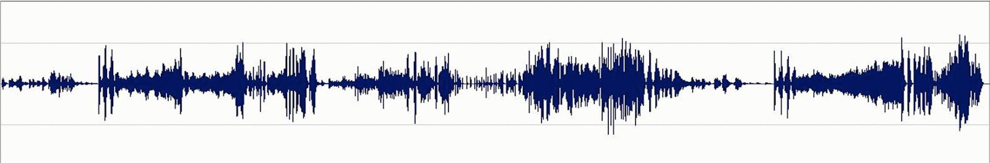
2.1 Basic Sound Concepts
•
Sound is the physical phenomenon produced by the
vibration of matter such as violin string or block of wood.
•
When a matter vibrates, pressure variations are created in
the air surrounding it.
•
This alteration of high and low pressure is propagated
through the air in a wave like motion. When the wave
reaches the human ear, a sound is heard.

Slide 57
2.1 Basic Sound Concepts
•
The pattern of the oscillation is called a waveform.
•
The
waveform
repeats
the
same
shape
at
regular
intervals and this point is called a period.
•
Since
sound
wave
forms
occur
naturally,
Sound
waves
are
never
perfectly
smooth
or
uniformly
periodic.
•
Periodic sound: E.g. Musical instruments, vowel sounds,
whistling wind, bird songs etc.
•
Non-periodic
sound:
E.g.
Unpitched
percussion
Instruments,
coughs,
sneezes,
rushing
water,
Consonants,.
Notes:
Percussion: musical instruments played by striking with the hand or with a stick

Slide 58
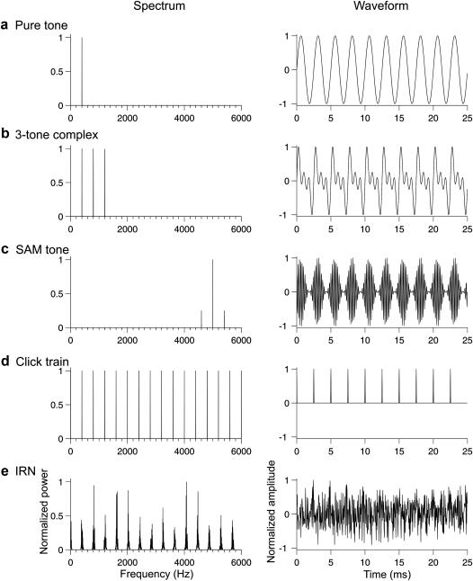
2.1 Basic Sound Concepts
Periodic Sound

Slide 59
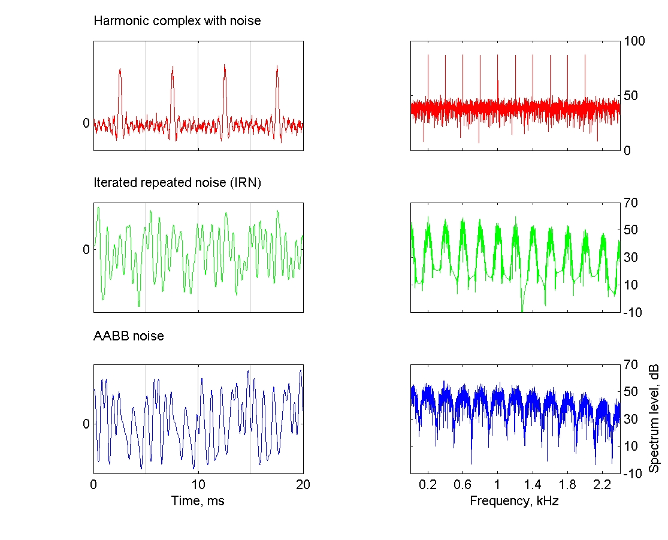
2.1 Basic Sound Concepts
Non Periodic Sound

Slide 60
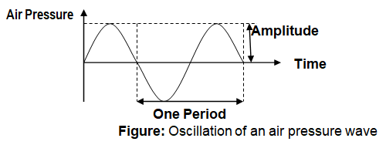
2.1 Basic Sound Concepts

Slide 61
2.1 Basic Sound Concepts
Frequency
•
The frequency of a sound is the reciprocal value of the period.
It represents the number of periods in a second. It is
measured in hertz (Hz) or cycles per second (cps).
1 KHz = 1000 Hz
Some of the frequency ranges are:
•
Infra sound –
0 - 20 Hz
•
Human audible sound –
20 Hz - 20KHz
•
Ultra sound –
20KHz - 1GHz
•
Hyper sound –
1GHz - 10THz
Human audible sound is also called audio or acoustic
signals (waves). Speech is an acoustic signal produced by the
humans.

Slide 62
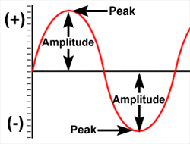
2.1 Basic Sound Concepts
Amplitude
The amplitude of the sound is the measure of the
displacement of the air pressure wave from its mean or
quiescent state.
i.e. Distance moved by a point on a vibrating body
or wave measured from its equilibrium position.
A
sound
has
an
amplitude
property
subjectively
heard as loudness

Slide 63
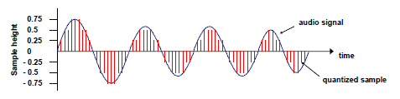
2.1 Basic Sound Concepts
Computer representation of sound
•
A transducer converts pressure to voltage levels
•
The analog signal is converted into a digital stream by discrete sampling:
•
The analogous signal is sampled in regular time intervals, i.e. the amplitude
of the wave is measured
•
Discretization both in time and amplitude (quantization) to get representative
values in a limited range (e.g. quantization with 8 bit: 256 possible values)
•
Result: series of values:

Slide 64
2.1 Basic Sound Concepts
Computer representation of sound
The smooth, continuous curve of a wave form is not
directly represented in a computer. A computer measures
the amplitude of the waveform at regular time intervals
to produce a series of numbers called samples.
Audio
signals
are
converted
into
digital
samples
through Analog-to-Digital Converter (ADC). The reverse
mechanism is performed by a Digital-to Analog Converter
(DAC).
E.g.
of
ADC
is
AM79C30A
digital
subscriber
controller chip.

Slide 65
2.1 Basic Sound Concepts
Sampling
Sound wave form the smooth, continuous is not
directly represented in the computer.
The computer measures the amplitude of the wave
form in the regular time interval to produce the series the
numbers. Each of this measurement is called sample. This
process is called sampling.
Sampling rate:
the rate at which a continuous wave
form is sampled is called sampling rate. Like frequency,
sampling rate are measured in Hz. For loss less digitization
the sampling rate should be at least twice of the maximum
frequency response.

Slide 66
2.1 Basic Sound Concepts
Sampling Rate..
Nyquist Sampling Theorem: “For lossless digitization, the
sampling
rate
should
be
at
least
twice
the
maximum
frequency responses”.
E.g. CD standard sampling rate of 44100Hz means that the
waveform is sampled 44100 times per second. A sampling
rate of 44100 Hz can only represent frequencies up to
22050 Hz.

Slide 67
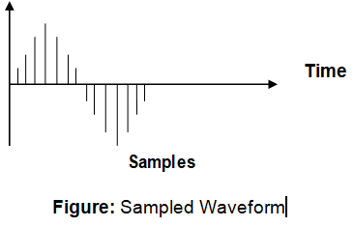
2.1 Basic Sound Concepts
Sample Height

Slide 68
2.1 Basic Sound Concepts
Quantization:
The
value
of
sample
is
discrete.
Resolution/Quantization of a sample value depends on the
no. of bits used in measuring the height of a waveform.
For E.g. An 8-bit quantization yields 256 values. 16-
bit CD quality quantization results over 65536 values.

Slide 69
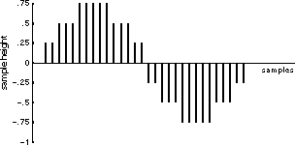
2.1 Basic Sound Concepts
•
Quantization:
Figure: Three-bit Quantization
Lower
the
quantization;
lower
the
quality
of
the
sound.
For
3-bit
quantization, values are 8. i.e. 0.75, 0.5, 0.25, 0, -0.25, -0.5, -0.75 & 1

Slide 70
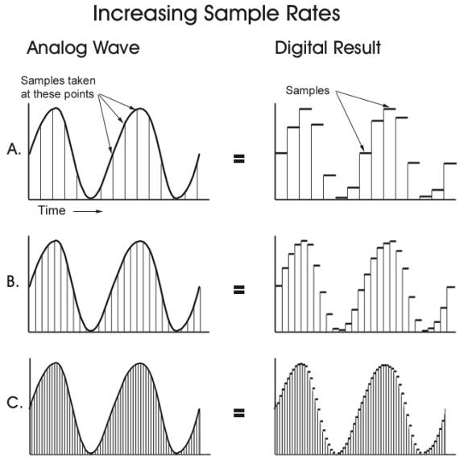
2.1 Basic Sound Concepts

Slide 71
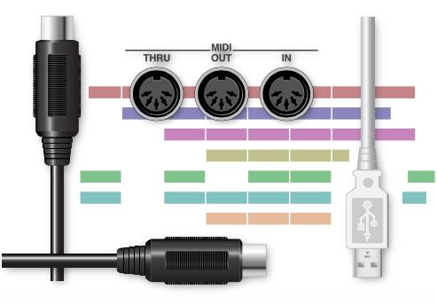
Basic Music(MIDI) Concepts

Slide 72
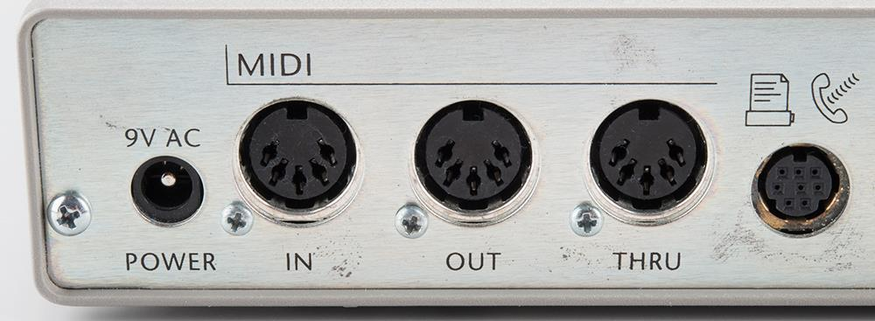
Basic Music(MIDI) Concepts
•
Music:
The relationship between music and computer has
become more and more important, especially considering
the development of MIDI (Musical Instrument and Digital
Interface)
and
its
important
contribution
in
the
music
industry.
MIDI interface between musical instrument and
computer.

Slide 73
Basic Music(MIDI) Concepts
•
MIDI Basic Concept:
MIDI is the standard that manufacturer of electronic
musical instrument have agreed upon.
It
is
set
of
specifications
used
for
building
the
instrument so that the instrument of one manufacturer can
without difficulty communicate musical information between
one another.
So that the instrument of different manufacturers
can communicate without difficulty. MIDI is defined in
1983.

Slide 74
Basic Music(MIDI) Concepts
MIDI Interface Components:
MIDI interface has two different components:
i. Hardware:
ii. A data format:
i. Hardware:
Hardware connects the equipment. It specifies
the physical connection between musical instruments.
A
MIDI
Port
is
built
in
to
the
instrument
and
it
specifies MIDI cable and deals with electronic signals that
are sent over the cable.

Slide 75
Basic Music(MIDI) Concepts
ii. A data format:
Data
format
encodes
the
information
travelling
through
the
hardware.
MIDI
doesn't
transmit
an
audio
signal.
For this propose MIDI data format is used. The MIDI
encoding includes, besides the instrument specification, the
notion of the beginning and ending node, basic frequency
and sound volume.
MIDI data format is digital. The data are grouped
into MIDI message. Each MIDI message can communicate
one musical event between instruments.

Slide 76
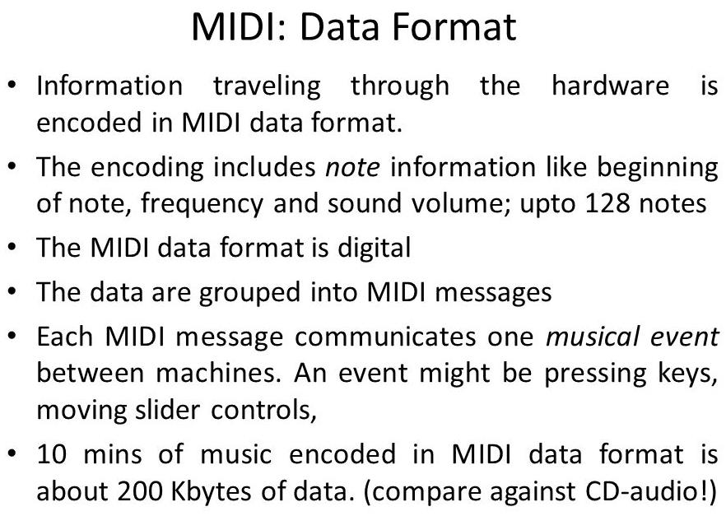
Basic Music(MIDI) Concepts

Slide 77
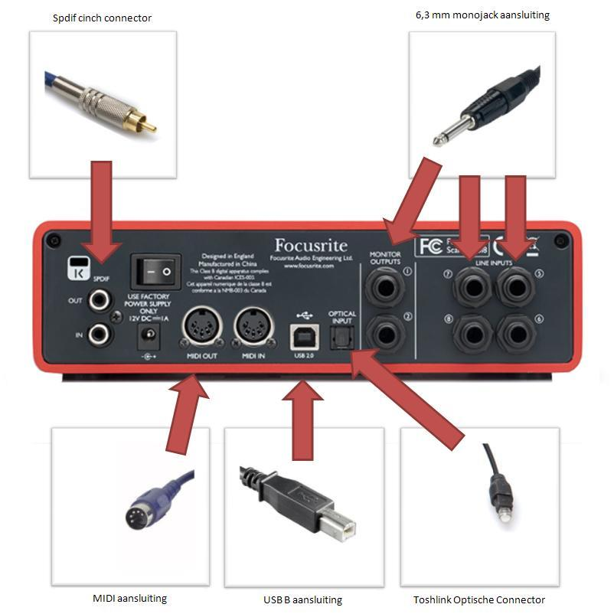
Basic Music(MIDI) Concepts

Slide 78
Basic Music(MIDI) Concepts
MIDI Reception Mode:
•
Mode 1: Omni on / poly
•
Mode 2: Omni on / mono
•
Mode 3: Omni off / poly
•
Mode 4: Omni off / mono

Slide 79
Basic Music(MIDI) Concepts
Omni On/Off:
If Omni if turned on, the MIDI device monitors all the
MIDI channels and responds to all channels messages. If
it is turned off, the MIDI device responds only to channel
messages sent on the channels the device is set to
receive.
Omni Poly/Mono:
Of Poly is set, the device can play several notes at a
time. If the mono is set, the device plays notes like
monophonic synthesizer-one note at a time.

Slide 80
Basic Music(MIDI) Concepts
The first half of the mode name specifies how MIDI
device monitors the incoming MIDI channels. If Omni is
turned on, the MIDI device monitors all the MIDI channels
and responds to all channel messages, no matter which
channels they are transmitted on. If the Omni is turned off,
the MIDI device respond only to channel message, the
device is set to receive.
The second half of the mode name tells the MIDI
device how to play nodes coming in over the MIDI cable. If
the option Poly is set the device can play several nodes at
a time. If the node is set to mono the device play only one
node at a time like a monophonic synthesizer.

Slide 81
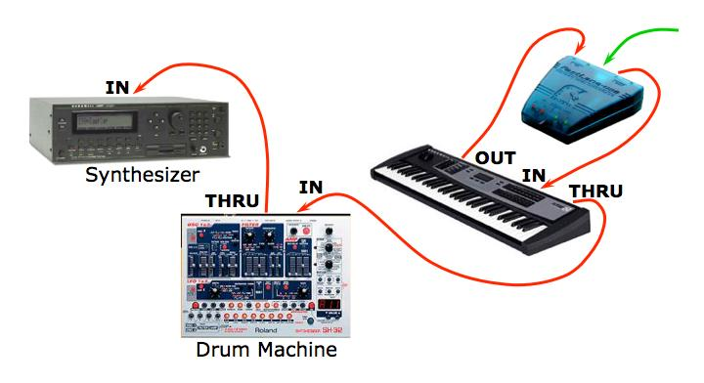
Basic Music(MIDI) Concepts
MIDI Devices
MIDI synthesizer device is the heart of MIDI system.
Most synthesizers have following components.
1.
Sound generators
2.
Microprocessor
3.
Keyboard
4.
Control panel
5.
Auxiliary controllers
6.
Memory
7.
Drum machine
8.
Master keyboard
9.
Guitar Synthesizer

Slide 82
Basic Music(MIDI) Concepts
•
Sound generators:
It synthesizes the sound. It produces an audio signal that becomes
sound when fed into a loud speaker. It can change quality of sound by
varying the voltage oscillation of the audio. Sound generation is done in
2-ways:
•
Storing acoustic signals as MIDI data in advance
•
Creating acoustic signals synthetically
•
Microprocessor:
Microprocessor communicates with the keyboard to know which notes
the musician is playing. Microprocessor communicates with the control
panel to know what commands the musician wants to sent to the
microprocessor. The microprocessor then specifies note and sound
commands to the sound generators (i.e. microprocessor sends and
receives the MIDI message).
•
Keyboard:
It affords the musician‟s direct control of the synthesizer. Pressing keys
means signaling microprocessor what notes to play and how long to
play them. Keyboard should have at least 5 octaves and 61 keys.

Slide 83
Basic Music(MIDI) Concepts
•
Control panel:
Controls those function that are not directly concerned with notes and
duration. Control panel includes a slider, a button and a menu.
•
Auxiliary controllers:
Gives more control over the notes played on keyboard. Pitch bend and
modulation are the 2 common variables on the synthesizer
•
Memory:
Stores patches for the sound generation and settings on the control
panel.
•
Drum machine:
Specialize in percussion sounds and rhythms.
•
Master keyboard:
Increases the quality of the synthesizer
•
Guitar Synthesizer:
Drum pad controllers, Guitar controllers and many more

Slide 84
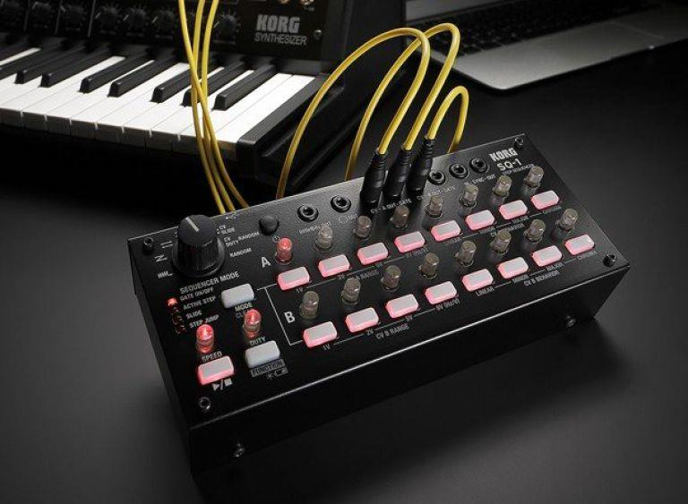
Basic Music(MIDI) Concepts
Sequencer:
It is an electronic device in cooperating with both
hardware and software, which is used as storage server for
generated
MIDI
data.
A
sequencer
may
be
computer.
Sequencer transforms the note into MIDI message.

Slide 85
Basic Music(MIDI) Concepts
MIDI Message:
MIDI messages transmit information between MIDI
devices and determine what kinds of musical events can be
passed from device to device.
Formats of MIDI messages
•
Status byte: First byte of any MIDI message. It describes
the kind of message
•
Data byte: The following bytes.

Slide 86
Basic Music(MIDI) Concepts
There are two types of MIDI messages
1.
Channel Message (:
It go only to specified devices
)
i.
Channel Voice Message
ii.
Channel mode Message
2.
System Message (:
It
go to all devices in a MIDI system
)
i.
System Real-time message
ii.
System Common Message
iii.
System exclusive Message

Slide 87
Basic Music(MIDI) Concepts
1. Channel Message: It go only to specified devices. There
are two types of channel message.
i.
Channel Voice Message: (
send actual performance between devices
)
Channel Voice message send actual performance data between
MIDI devices describing keyboard action, controller action and control
panel changes. E.g. note on, Note off, channel pressure, control change
etc.
ii.
Channel Mode Message: (
determine
how to play notes
)
Channel Mode message determine the way that a receiving MIDI
device respond to channel voice message. It deals with how to play
notes coming in over MIDI cables. Channel mode message includes Omni
On, Omni Off, note off, note on, etc. E.g. local control, All note off, Omni
mode off etc.

Slide 88
Basic Music(MIDI) Concepts
2. System message: System message go to all devices in
a MIDI system because no channel number are specified.
There are three types of system message.
i.
System Real-time Message: (
avoid delay time
)
These are very short and simple, consisting of only one byte. They
carry extra data with them. These messages synchronize the timing
MIDI devices in performance. To avoid delay these message are sent
in the middle of other message if necessary. E.g. System reset, Timing
clock i.e. MIDI clock etc.
ii.
System Common Message: (
prepare sequence
)
System common message are commands that prepares sequencers
and synthesizer to play song. E.g. Song selected, find the common
starting place in the song.
iii.
System Exclusive message: (
create customize message
)
System
exclusive
message
allow
MIDI
manufacturers
to
create
customized MIDI message to send between the MIDI devices.

Slide 89
Basic Music(MIDI) Concepts
MIDI Software
The software application generally falls into four major
categories.
1.
Music recording and performance application
2.
Musical notation and printing application
3.
Synthesizer Patch editor and library patch
4.
Music education application

Slide 90
Basic Music(MIDI) Concepts
1.
Music recording and performance applications: Provides
function as recording of MIDI messages. Editing and playing
the messages in performance.
2.
Musical
notations
and
printing
applications:
Allows
writing music using traditional musical notation. User can
play
and
print
music
on
paper
for
live
performance
or
publication.
3.
Synthesizer path editor and librarians: Allows information
storage of different synthesizer patches in the computer's
memory and disk drives. Editing of patches in computer.
4.
Music education applications: Teaches different aspects of
music
using
the
computer
monitor,
keyboard
and
other
controllers of attached MIDI instruments.

Slide 91
Basic Music(MIDI) Concepts
MIDI and SMPTE Timing Standard
MIDI reproduces traditional note length using MIDI clock,
which are represented through timing clock message. Using
MIDI clock a receiver can synchronize with the clock cycle of
sender.
To
keep
the
standard
timing
reference
the
MIDI
specification state 24 MIDI clock = 1 quarter note.
As an alternative the SMPTE timing standard (Society
Of Motion Picture and Television Engineer) can be used. The
SMPTE timing standard was originally developed by NASA as a
way to make incoming data from different tracking stations so
that the receiving computer could fill what time each piece of
data was created. SMPTE format consists of hour: minutes:
second: frames: bits
-30 frames per second, SMPTE uses a 24 hour clock
from 0 to 23 before recycling.

Slide 92
Basic Music(MIDI) Concepts
Processing chain of interactive computer music systems
•
Sensing stage: Data is collected from controllers reading the
gesture information from human performers on stage.
•
Processing stage: Computer reads and interprets information
coming from the sensors and prepares data for the response
stage.
•
Response stage: Computer ad some collection of sound
producing devices share in realizing a musical output
Some of the interactive music systems:
✓
Max (OOP language)
✓
Cypher (It has a listener and a player)
✓
NeXT Computer (It has a music kit)
✓
M & Jam Factory (It has graphics control panel)

Slide 93
Assignment II
1.
Explain
the
different
components
of
a
MIDI device.
2.
Illustrate the importance of MIDI. Explain
the significance of MIDI messages.
3.
What
is
MIDI?
What
features
of
MIDI
make
it
suitable
for
multimedia
applications?
.

Slide 94
6.3 Video:
6.3.1 Digital video formats (AVI and MOV)
6.3.2 Video codecs, frame rate, resolution and color
depth
6.4 Animation:
6.4.1 Hand drawn, stop motion and computer
animation
6.4.2 Morphing

Slide 95
3. Video and Animation Technology
3.1. Basic Video Concept: Representation and Format
3.2 Television: High Definition Television(HDTV)
3.3 Animation: Types of Animation
3.3.1 Computer Based Animation
3.3.2 Handwritten Animation
3.3.3 Stop Motion Animation
3.4 Design Principles of Animation,
Methods of ControllingAnimations

Slide 96
Basic Video Concepts
Video Signal Representation
In
conventional
TV
sets,
the
video
signal
is
displayed using a cathode ray tube. An electron beam
carries corresponding pattern information such as intensity
in a viewed scene.
Video signal representation includes three aspects:
1.
the visual representation
2.
transmission
3.
digitization

Slide 97
Basic Video Concepts
1. Visual Representation
The objective is to offer the viewer a sense of presence in the
scene
and
of
participation
in
the
events
portrayed.
To
meet
the
objective, the televised images should convey spatial and temporal
content of the scene.
Important measures taken for the purpose include
1.
Vertical Detail and the Viewing Distance
2.
Horizontal Detail and Picture Width
3.
Total Detail Content of the Image
4.
Perception of Depth
5.
Luminance and Chrominance
6.
Temporal Aspects of Illumination
7.
Continuity of Motion
8.
Flicker
9.
Temporal Aspect of Video Bandwidth

Slide 98
Basic Video Concepts
1)Visual Representation
1. Vertical Detail and the Viewing Distance
Geometry of the field occupied by the television image is
based on the ratio of picture width and height, called as aspect
ratio (W/L=4/3=1.33)
Viewing
distance
D
determines
the
angle
H
subtended
by
the
picture
height.
The
angle
is
usually
measured by the ration of the viewing distance to the picture
height (D/H). The smallest detail that can be reproduced in the
image is pixel
Both the number of pixels per scanned line and the
number of lines per frame vary; the actual numbers used being
determined by the aspect ratio. This is the ratio of the screen
width to the screen height. The aspect ratio of current television
tubes is 4/3 with older tubes – on which PC monitors are based
– and 16/9 with widescreen television tubes.

Slide 99
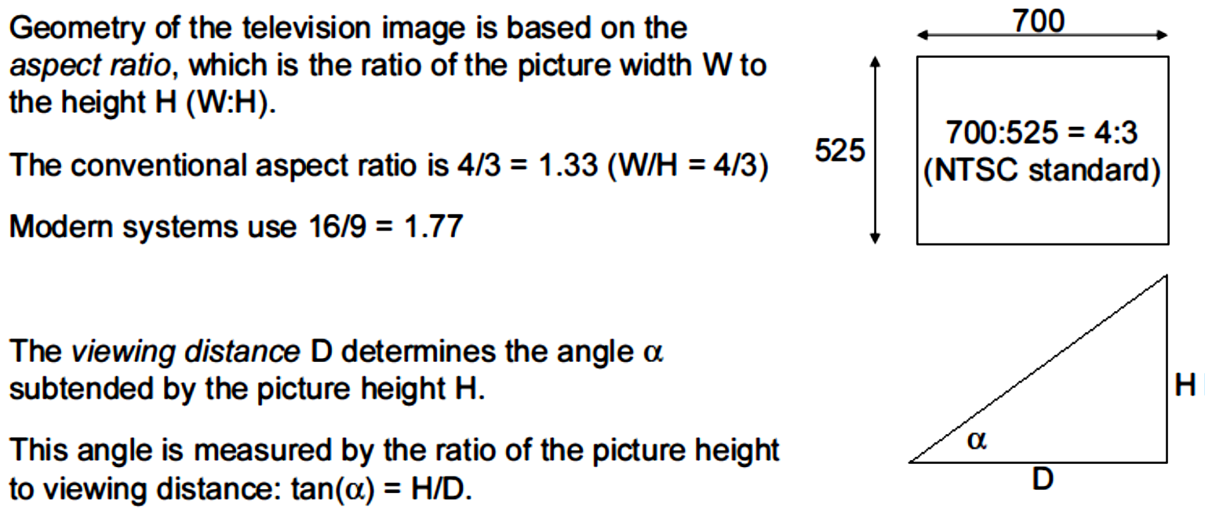
Basic Video Concepts
1)Visual Representation
1. Vertical Detail and the Viewing Distance (cont..)

Slide 100
Basic Video Concepts
1)Visual Representation(cont..)
2.Horizontal Detail and Picture Width
Picture width chosen for the conventional television
services is
4/3 * picture height
. Using the aspect
ratio, we can determine the horizontal field of view from the
horizontal angle.
The horizontal detail or the picture width is again
dependent upon the aspect ratio and is given by aspect
ratio*height of picture.

Slide 101
Basic Video Concepts
1)Visual Representation(cont..)
3. Total Detail Content of the Image
The vertical resolution is equal to the number of picture
elements separately presented in the picture height, while the
number
of
elements
in
the
picture
width
is
equal
to
the
horizontal resolution times the aspect ratio.
The product of horizontal and vertical elements gives the
total picture elements in the image.
The total detail content of the image is given by the
number of pixels used to represent the image and is given by the
resolution.
Thus total detail content of the image is the product of
Vertical Detail * Horizontal Detail.

Slide 102
Basic Video Concepts
1)Visual Representation(cont..)
4.Perception of Depth
In natural vision, perception of the third spatial(3D/4D)
dimension, depth, depends primarily on the angular separation
of the images received by the two eyes if the viewer.
In the flat image television, a considerable degree of
depth perception is inferred from the perspective appearance of
the subject matter.
As the screen is two dimensional a special measure is
taken to give the sense of depth. This involves the perspective
representation of the image content. This is again governed by
the focal length of the lenses and changes in depth of focus in
camera.

Slide 103
Basic Video Concepts
1)Visual Representation(cont..)
5.Luminance and Chrominance
Color
vision
is
achieved
through
three
signals,
proportional to the relative intensities of Red, green and blue
lights (RGB) in each portion of the scene.
During the transmission of the signals from the camera to
the
television
(display),
a
different
division
of
signals
in
comparison to the RGB division is often used.
This
color
encoding
during
transmission
uses
luminance and chrominance.
The term luminance is used to refer to the brightness of
a
source,
and
the
color
information
is
referred
by
the
chrominance.
Human eye however is more sensitive to luminance than
to chrominance. The color encoding during transmission uses
luminance and two chrominance signals (for hue and saturation).

Slide 104
Basic Video Concepts
1)Visual Representation(cont..)
5.Luminance and Chrominance(cont..)
Thus
luminance
(Y
)
and
two
chrominance
blue
s
chrominance(C
), and the red chrominance(C
) are then
b
r
used to represent the video content where
Y
=0.299 R
+ 0.587 G
+ 0.144 B
s
s
s
s
C
= B
-Y
and
b
s
s
C
=R
-Y
r
s
s

Slide 105
Basic Video Concepts
1)Visual Representation(cont..)
6.Temporal Aspects of Illumination
In contrast to continuous pressure waves of an acoustic
signal,
a
discrete
sequence
of
individual
pictures
can
be
perceived as a continuous sequence.
This property is used in television and motion pictures.
The rate of repetition of the images must be high enough to
guarantee
smooth
motion
from
frame
to
frame
and
the
persistence of vision extends over the interval between flashes.
One of the major characteristics of human eye is that if
the still images are shown in rapid succession, human eye
perceive the motion i.e. it does not notice the brief cut off of the
light.
Thus if the rate of succession is sufficiently high still
images can be used to represent motion as the persistence of
vision extends over the interval between flashes.

Slide 106
Basic Video Concepts
1)Visual Representation(cont..)
7.Continuity of Motion
NTSC
(National
Television
Systems
Committee)
specified the frame rate for maintaining the visual-aural carrier
separation
at
4.5
MHz
was
30
frames/sec
but
has
been
changed to 29.97 HZ.
PAL
(Phase
Alternating
Line)
adopted
the
frame
repetition rate of 25 Hz, and the frame rate is 25frames/sec.
Digital motion picture uses frame rate of 50 frames/sec.
As stated above, motion can be represented by showing
the
still
images
in
rapid
succession.
This
can
be
done
by
showing the still images 15 frames per second. Video motion
seems smooth and is achieved at only 30 frames per second.

Slide 107
Basic Video Concepts
1)Visual Representation(cont..)
8.Flicker
Through
a
slow
motion,
a
periodic
fluctuation
of
brightness perception, a flicker effect arises. The marginal value
to avoid flicker is at least 50 refresh cycles per second.
To achieve continuous flicker-free motion, we need
relatively high refresh frequency.
Movies and television apply some technical measures to
work with lower motion frequencies. When the refresh rate of
frames is smaller than the eye will notice the cutoff of light
between the frames and there arises the flickering rate. The
marginal value to avoid flicker is at least 50 refresh cycles per
second.

Slide 108
Basic Video Concepts
1)Visual Representation(cont..)
9.Temporal Aspect of Video Bandwidth
The most important factor to determine at which bandwidth the
video
can
be
transmitted
is
its
temporal
specification.
Temporal
specification depends on the rate of the visual system to scan pixels, as
well as on the human eye‟s scanning capabilities.
In a HDTV (High Definition TV) device, a pixel can be scanned
in less than a tenth of a millionth of a second. From the human visual
perspective, the eye requires that a video frame to be scanned every
1/25 second, this time is equivalent to the time during which human eye
does not see the flicker effect.
The choice of bandwidth for transmission of the video signal
depends on the rate of the visual system to scan pixels, as well as on
the
human
eye‟s
scanning
capabilities.
From
the
human
visual
perspective, the eye requires that a video frame be scanned every 1/25
second.

Slide 109
Basic Video Concepts
2) Transmission
Standards
for
transmission
of
video
are:
NTSC
(National Television System Committee) and PAL (Phase
Alternating Line). Approaches of color encoding are: RGB,
YUV (luminance Y, two chrominance channels U and V),
YIQ, Composite, etc.
Different color encoding techniques can be employed while
transmitting the video signal and they are:
i.
RGB signal
ii.
YUV signal
iii.
YIQ signal
iv.
Composite signal

Slide 110
Basic Video Concepts
i. RGB signal
In
this
case
separate
signal
coding
is
done
for
the
individual R, G and B components of the image and these
components are transmitted separately.
ii.YUV signal
This model exploits the fact that the human eye is more
sensitive to brightness i.e. luminance than to color information
i.e.
chrominance.
Thus
instead
of
separating
the
color
component the brightness and the coloration of the image is
separated.
Thus
luminance(Y
)
and
two
chrominance
blue
chrominance
(C
s
), and the red chrominance
(C
)
b
r
are then used to represent the video content where
Y
=0.30 R
+ 0.59 G
+ 0.11 B
s
s
s
s
U = (B
-Y
) x 0.493
s
s
V=(R
-Y
) x 0.877
s
s

Slide 111
Basic Video Concepts
2) Transmission (cont..)
iii.YIQ signal
This model is very much similar to YUV model and is
used in NTSC system. The image information is broken
down into three components a luminance component and
two chrominance component given by following relation.
Y =0.30 R
+ 0.59 G
+ 0.11 B
s
s
s
I =0.60 R
- 0.28 G
+ 0.32 B
s
s
s
Q =0.21 R
+ 0.52 G
+ 0.31 B
s
s
s

Slide 112
Basic Video Concepts
2) Transmission(cont..)
iv. Composite signal
The alternative to component coding composes all
information into one signal; consequently, the individual
components (RGB, YUV, and YIQ) must be combined into
one signal.
The
basic
information
consists
of
luminance
information and chrominance difference signals.

Slide 113
Basic Video Concepts
3) Digitalization
Digitalization
is
a
process
of
changing
the
continuously varying signal into discrete components.
This
basically
uses
mathematical
process
like
Fourier analysis or a series of step consisting of sampling
and quantizing.
Sampling is the process that actually digitizes the
spatial position of the image while quantizing digitizes its
color information.
Sampling involves dividing the picture at M*N array
of points while quantizing involves dividing the signal into a
range of gray level values.
Finally
the
digital
motion
video
is
created
by
digitizing the pictures temporally.

Slide 114
Basic Video Concepts
Computer Video Format
Computer video format depends on the input
and output devices for the motion video medium
✓
Current video digitizers differ in digital image
resolution, quantization and frame rate
✓
Most often used display is raster display
✓
The raster display architecture (as shown
below)

Slide 115
Basic Video Concepts
Some
computer
video
controller
standards
(Computer Video Formats) are given below:
Color Graphics Adapter (CGA)
Resolution: 320*200
Color depth: 2 bits/pixel
Image size: 16 KB
No. of colors: 4
Storage Capacity: 320*200*4/8=16,000 bytes
Enhanced Graphics Adapter (EGA)
Resolution: 640*350
Color depth: 4 bits/pixel
Image size: 112 KB
No. of colors: 16
Storage Capacity: 640*480*4/8=112,000 bytes

Slide 116
Basic Video Concepts
Video Graphics Array (VGA)
Resolution: 649*480
Color depth: 8 bits/pixel
Image size: 307.2 KB
No. of colors: 256
Storage Capacity: 640*480*8/8=307,200 bytes
8514/A Display Adapter Mode
Resolution: 1024*768
No. of colors: 256
Storage Capacity: 1024*768*8/8=786,432 bytes

Slide 117
Basic Video Concepts
Extended Graphics Array (XGA)
Resolution: 640*480 / 1024*768
Color depth: 65,000 colors / 256
colors No. of colors: 256
Storage Capacity: 1024*768*8/8=786,432 bytes
Super VGA (SVGA)
Resolution: 1024*768
Color depth: 24 bits/pixel
Image size: 2.35 MB
No. of colors: 2
24
Storage Capacity: 1024*768*24/8=2,359,296 bytes

Slide 118
Television
Conventional Systems
Conventional
television
systems
employ
the
following standards:
NTSC
SECAM
PAL

Slide 119
Television
NTSC
•
National Television Systems Committee
•
Developed in the U.S.
•
Oldest and most widely used television standard
•
Color carrier is used with approximately 4.429 MHz or
with approximately 3.57 MHz.
•
Uses
a
quadrature
amplitude
modulation
with
a
suppressed color carrier
•
Works with a motion frequency of approximately 30 Hz
•
A picture consists of 525 lines
•
4.2 MHz is used for the luminance and 1.5 MHz is used
for each of the two chrominance channels.

Slide 120
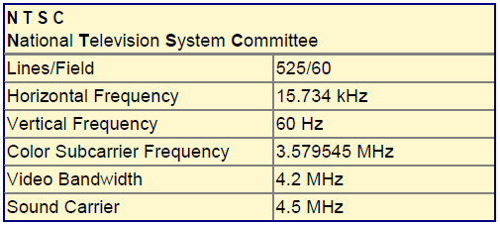
Television

Slide 121
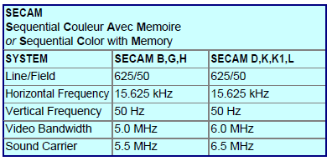
Television
SECAM
•
SEquential Couleur Avec Memoire
•
Used in France and Eastern Europe
•
Unlike NTSC and PAL, it is based on frequency modulation
•
Uses a motion frequency of 25 Hz
•
Each picture has 625 lines

Slide 122
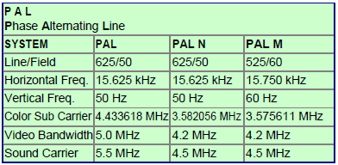
Television
PAL
•
Phase Alternating Line
•
Invented in 1963 by W. Bruch
•
Used in parts of Western Europe
•
Uses a quadrature amplitude modulation similar to NTSC, but the
color carrier is not suppressed

Slide 123
Television
High Definition Television
The formats used in HDTV are:
•
720p - 1280x720 pixels progressive
•
1080i - 1920x1080 pixels interlaced
•
1080p - 1920x1080 pixels progressive
HDTV is high-resolution digital television (DTV) combined with Dolby
Digital surround sound (AC- 3).
HDTV is the highest DTV resolution in the new set of standards. This
combination creates a stunning image with stunning sound. HDTV
requires new production and transmission equipment at the HDTV
stations, as well as new equipment for reception by the consumer.
The higher resolution picture is the main selling point for HDTV.

Slide 124
Television
High Definition Television
High-Definition Television (HDTV) is defined by the image it presents to
its viewer, which has the following characteristics:
Resolution
The HDTV image has approximately twice as many horizontal and
vertical pixels as conventional systems. Luminance detail is also increased by
employing
a
video
bandwidth
approximately
five
times
that
used
in
conventional systems.
Aspect Ratio
The aspect ratio of the HDTV images is 16/9 = 1.777.
Viewing Distance
Since the eye‟s ability to distinguish details is limited, the more
detailed HDTV image should be viewed closer than conventional systems.

Slide 125
Basic Concepts of Animation
•
Animation
is
the
process
of
making
the
illusion
of motion and change
by means of the rapid display of a
sequence of static images that minimally differ from each
other. The illusion—as in motion pictures in general—is
thought to rely on the phenomenon. Animators are artists
who specialize in the creation of animation.
•
Animation is the creation of the ―illusion of movement‖
using a series of still images.
•
A collection of static image joined together and shown
consecutively so that appear to move.

Slide 126
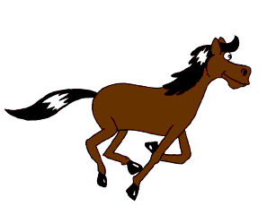
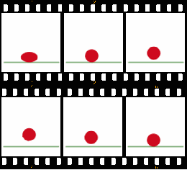

Basic Concepts of Animation
•
Animation
creation
methods
include
the
traditional
animation
creation
method
and
those
involving
stop
motion
animation
of
two
and
three-dimensional
objects, paper cutouts, puppets and clay figures. Images
are displayed in a rapid succession, usually 24, 25, 30, or
60 frames per second.

Slide 127
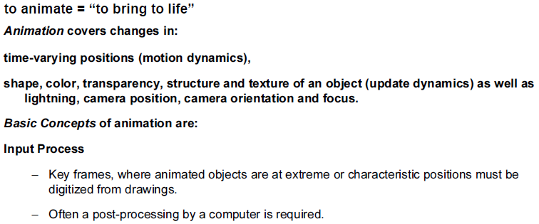
Basic Concepts of Animation

Slide 128
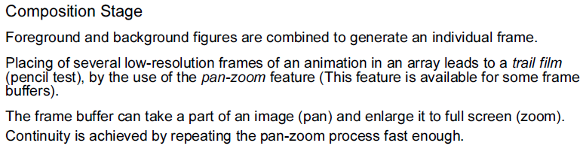
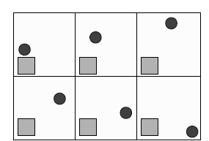
Basic Concepts of Animation

Slide 129
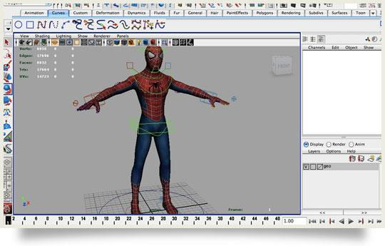
Basic Concepts of Animation

Slide 130

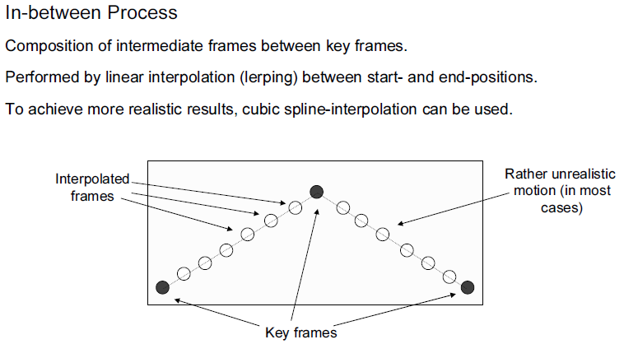
Basic Concepts of Animation

Slide 131
3. Video and Animation Technology
3.1. Basic Video Concept: Representation and Format
3.2 Television: High Definition Television(HDTV)
3.3 Animation: Types of Animation
3.3.1 Computer Based Animation
3.3.2 Handwritten Animation
3.3.3 Stop Motion Animation
3.4 Design Principles of Animation,
Methods of ControllingAnimations

Slide 132
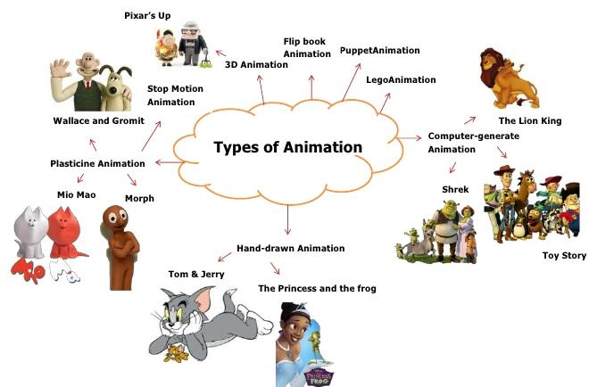
Types of Animation

Slide 133
Types of Animation
•
Hand Drawn Animation
•
Stop Motion Animation
•
Computer animation

Slide 134
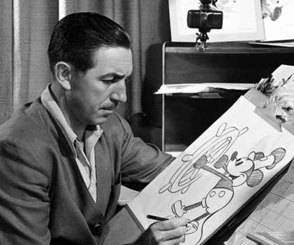
Types of Animation
1. Hand Drawn Animation
•
Done by an artist who draws each character and movement individually
•
Very time consuming to have to draw, then color, then photograph
each picture
•
Draw pictures first, then color them on celluloid,
Then they pictures and animate them
•
Very expensive due to hours of labor involved
•
Examples: older Disney Movies i.e. Bambi, Fox and Hound,
Cinderella etc.

Slide 135
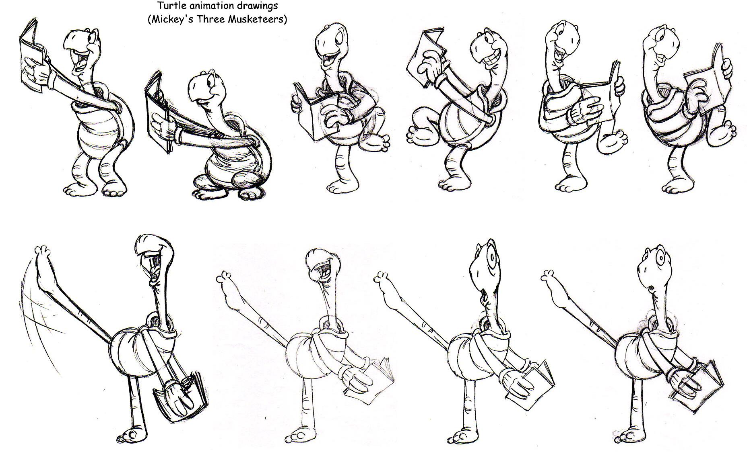
Types of Animation
1. Hand Drawn Animation

Slide 136
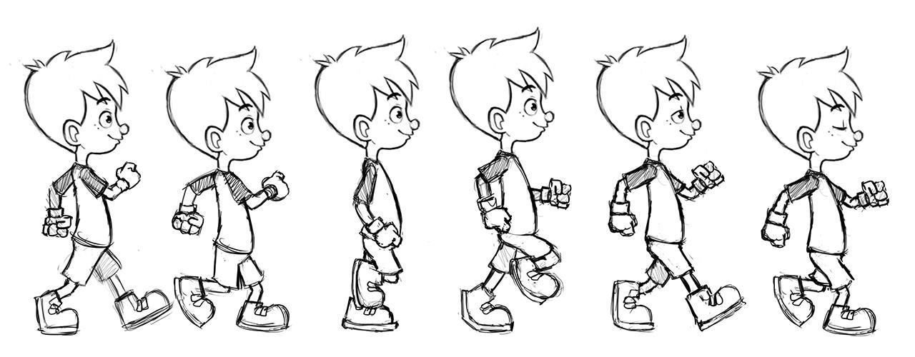
Types of Animation
1. Hand Drawn Animation

Slide 137
Types of Animation
2. Stop Motion Animation
•
Can be done by virtually anyone, with no extensive training
•
Does not take that much time relative to the other 2 methods
•
Uses jointed figures or clay figures that can be moved to make
motions
•
Take
still
pictures
of
the
individual
movements,
then
use
relatively inexpensive computer software to animate
•
We use Movie Maker Software to complete our animations
•
Not very expensive because all you need is a digital camera
and the software comes with windows XP operating system
•
Examples: star wars, robot chicken, old Rudolph the red Nosed
Reindeer.

Slide 138
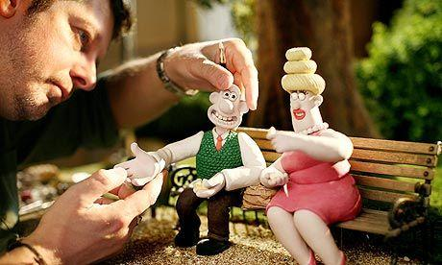
Types of Animation
2. Stop Motion Animation

Slide 139
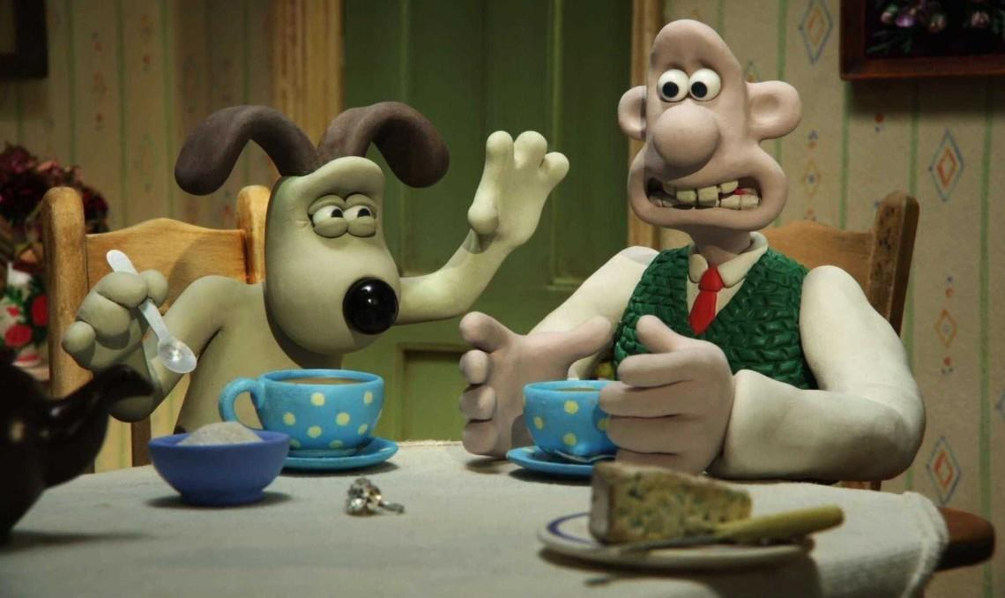
Types of Animation
2. Stop Motion Animation

Slide 140
Types of Animation
3. Computer Animation
•
All
characters
and
movements
are
generated
using
computer animation software
•
Can also be very time consuming as they can get very
complicated in movements and effects
•
All characters are fully animated with no still pictures
•
Can be very expensive because of the complexity of the
stunts and animation being done
•
Huge budgets because the animation sequences more
complicated these days eg. The war scenes in Lord of the
Rings etc.
•
Examples: Toy story , finding Nemo, Matrix, Lord of the
Rings

Slide 141
Basic Steps of Animation
1.
Shooting reference video
2.
Key posing
3.
Blocking
4.
Splining
5.
Smoothing
6.
Adding life

Slide 142
Basic Steps of Animation
1.
Shooting reference video
•
This is a very important and overlooked step. It‘s weird
how people really think they know what certain actions
look like and how long they take, but in reality they are
often wrong.
•
Physical
actions
is
something
you
need
to
analyze before animating, especially if you‘re a beginner.
•
You have a shot of a guy throwing a baseball? Better
YouTube some reference video of pitchers throwing balls.
Don‘t assume you know what an action looks like just
because you‘ve seen it before. Looking at an action as
an animator is completely different than looking at it as a
regular viewer.

Slide 143
Basic Steps of Animation
2.
Key posing
•
After shooting a reference, it‘s time to create the key
poses of the shot.
•
These poses are called key poses because they are the
most important poses of the shot. These are the poses
that convey the story of the shot. We better make sure
we get those poses right, because we‘re going to build
on those for the rest of the process.

Slide 144
Basic Steps of Animation
3.
Blocking
•
Once we‘re happy with our key poses, we start breaking
down the movement from each pose to the next by
adding ‗in between‘ (also known as breakdown poses or
passing poses). These are the poses that connect the key
poses.
•
We keep adding more poses until the movement looks as
good
as
it
could,
while
still
staying
in
stepped
mode
(stepped
mode
is
when
you
don‘t
allow
interpolation
between
poses,
which
results
in
a
very
choppy/blocky motion).

Slide 145
Basic Steps of Animation
4.
Splining
•
Splining is a 3D animation term. It‘s the process in which
you convert the interpolation of the keys from stepped to
spline. In other words – you make the computer connect
the
movement
between
each
of
your
poses,
and
that makes the movement look smoother.
•
The problem is that the computer doesn‘t do a very good
job at interpolating. It only works with what it has. That‘s
why the better the blocking is – the better the splined
version is going to look.

Slide 146
Basic Steps of Animation
5.
Smoothing
•
Now that all of our keys are on spline mode, we have to
work on them. We need to clean up all the curves and
make sure the movement looks smooth.
•
It‘s also a good idea to offset some of the actions so it
doesn‘t look so ‘stop and start’, as if the character
is doing all the motion at once. By the end of this step
your shot should look pretty solid and almost finished.

Slide 147
Basic Steps of Animation
6.
Adding life
•
This step is the a lot of fun. We‘ve already finished with
the grunt work of animating and it‘s time to add the fun
stuff. In this step we add small imperfections that bring
life to the character. Maybe an extra blink or a mouth
twitch here and there. The difference between the last 2
steps is small but very noticeable.

Slide 148
Transmission of Animation
•
Symbolic Representation
The symbolic representation (e.g. circle) of animation
objects (e.g. ball) is transmitted together with the operation
commands (e.g. roll the ball) performed on the object, and at the
receiver side the animation is displayed.
The transmission time is short because the symbolic
representation of an animated object is smaller in byte size than
its pixmap representation. However, the display time at the
receiver takes longer because the scan-converting operation has
to be performed at the receiver side.
The transmission rate (bits/sec or bytes/sec) of animated
objects depends on:
✓
The
size
of
the
symbolic
representation
structure,
where
the
animated object is encoded,
✓
The size of the structure, where the operation command is encoded,
and
✓
The number of animated objects and operation commands sent per
second.

Slide 149
Transmission of Animation
•
Pixmap Representation
The pixmap representation of the animated objects
is transmitted and displayed on the receiver side.
The transmission time is longer in comparison to the
previous because of the size of the pixmap representation.
However, the display time is shorter because the scan-
conversion
of
the
animated
objects
is
avoided
at
the
receiver side.
It is performed at the sender side where animation
objects
and
operation
commands
are
generated.
The
transmission rate of the animation is equal to the size of the
pixmap representation of an animated object (graphical
image) multiplied by the number of graphical images per
second.

Slide 150
Applications of Animation
•
Animated Movies: Million dollar industry;
•
1-20 millions spent on each movie
•
Animation and computer graphics effects are used in
movies frequently
•
Video games
•
TV programs(e.g. Weather, News)
•
Used online (images, ads, chatting)
•
Simulations (science and Engineering)
•
Virtual Reality (e.g. second life)

Slide 151
Morphing
It is derived from the word metamorphosis, which
means the transformation shape, appearance of one thing
into another. The transformation of object shapes from one
form to another is called morphing.
Also it can be defined as:
•
Transition from one object to another.
•
Process of transforming one image into another.

Slide 152
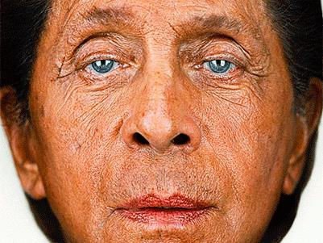
Morphing

Slide 153
Assignment IV
1.
What do you mean by computer based animation? List the
different types of animation languages.
2.
Explain
Tele-services
and
the
implementation
of
Conversation services in Multimedia communication.
3.
Explain the methods that are used to control animation.
4.
Discuss the YUV model for video transmission.
5.
How long will it take to transmit a ` minute long video of
spatial resolution 640×480, 32 bits per pixel and 12 frames
per second through a communication link at a constant rate
of 56 K bits PS.
6.
Describe the television standards.

Slide 154
References
•
Multimedia:
Computing,
Communications
and
Applications”,
Ralf
Steinmetz
and
Klara
Nahrstedt,
Pearson Education Asia
•
“Multimedia
Communications,
Applications,
Networks,
protocols ad Standards”, Fred Halsall, Pearson Education
Asia
•
“Multimedia Systems”, John F. Koegel Buford, Pearson
Education Asia

